Slide 1

CE101 Engineering Drawing Lec2: Conics and Curves
Indian Institute of Technology Guwahati
Notes:
Today we will discuss about the Modeling and

Slide 2
Conic Sections
Sections of a right circular cone obtained by cutting the cone in different ways
Depending on the position of the cutting plane relative to the axis of cone, three conic sections can be obtained
ellipse,
parabola and
hyperbola

Slide 3


CONIC SECTIONS
ELLIPSE, PARABOLA AND HYPERBOLA ARE CALLED CONIC SECTIONS
BECAUSE
THESE CURVES APPEAR ON THE SURFACE OF A CONE
WHEN IT IS CUT BY SOME TYPICAL CUTTING PLANES.
OBSERVE
ILLUSTRATIONS
GIVEN BELOW..
Ellipse
Section Plane
Through Generators
Section Plane
Parallel to Axis.
Rectangular
Hyperbola
Hyperbola
Parabola
Section Plane Parallel
to end generator.
Section Plane Parallel
to end generator.

Slide 4
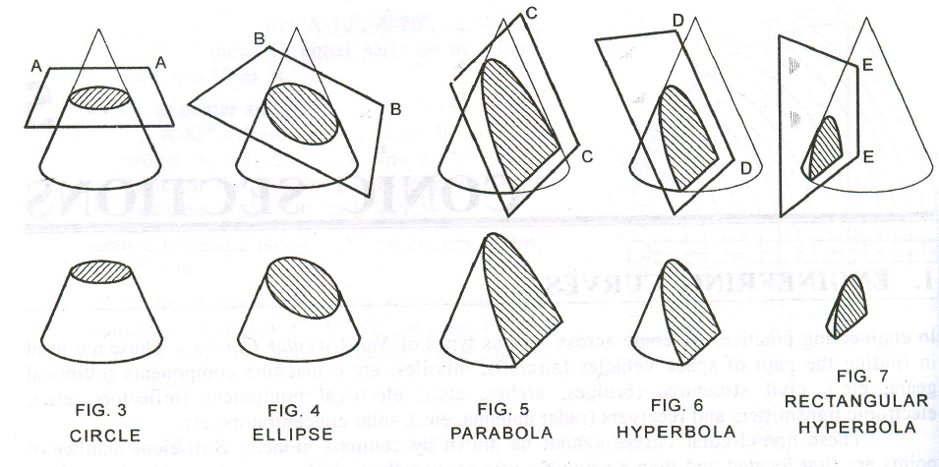

Slide 5
Conic Sections
An ellipse is obtained when a section plane A–A, inclined to the axis cuts all the generators of the cone.
A parabola is obtained when a section plane B–B, parallel to one of the generators cuts the cone. Obviously, the section plane will cut the base of the cone.
A hyperbola is obtained when a section plane C–C, inclined to the axis cuts the cone on one side of the axis.
A rectangular hyperbola is obtained when a section plane D–D, parallel to the axis cuts the cone.
O
A
B
C
A
D
O
B
C
D

Slide 6
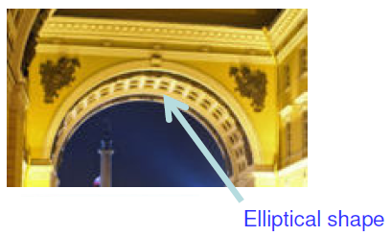
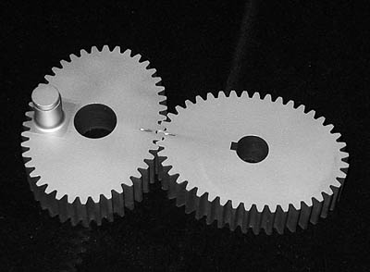
Few Applications of Ellipse
Arch
Elliptical gear

Slide 7
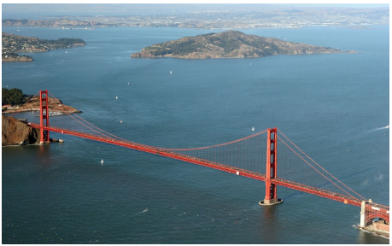
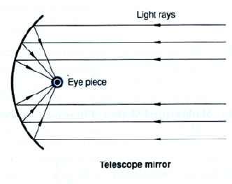
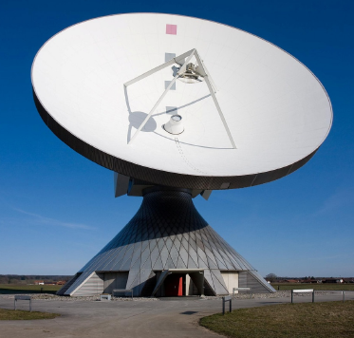
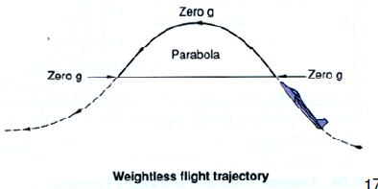

Few Applications of Parabola

Slide 8
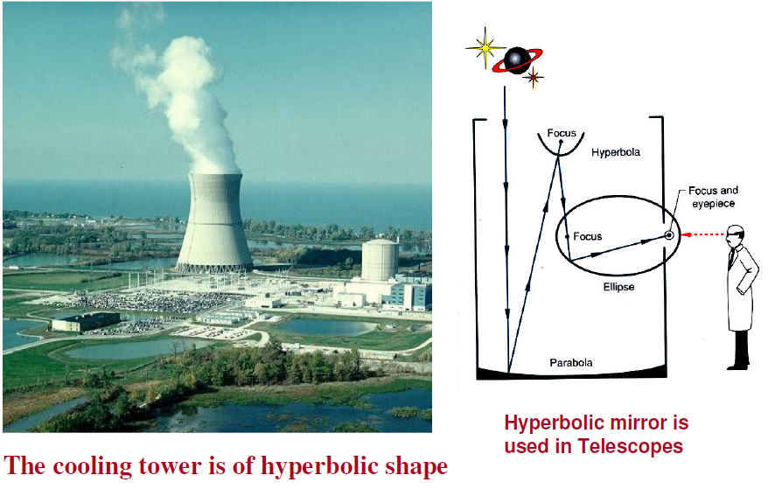
Few Applications of Hyperbola

Slide 9
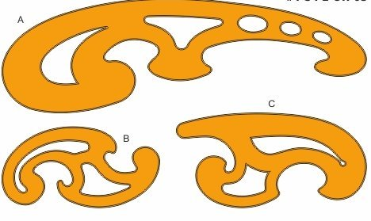
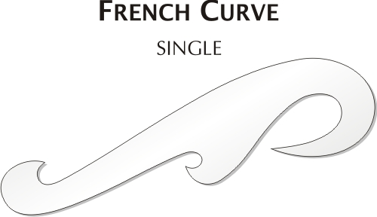
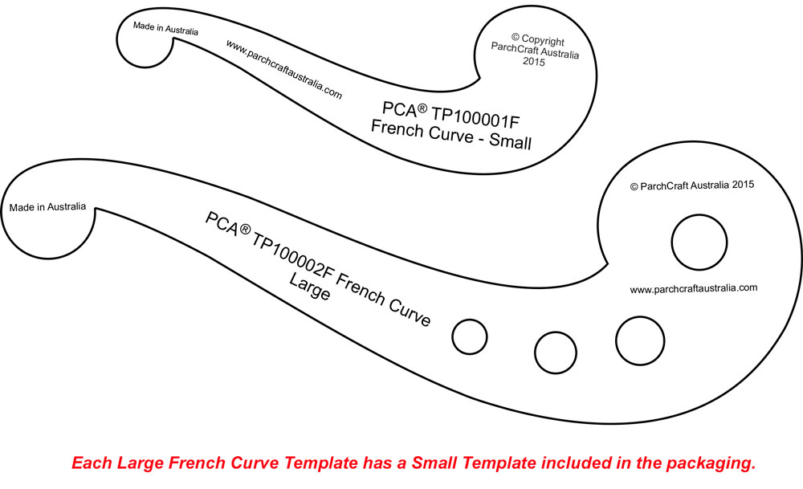
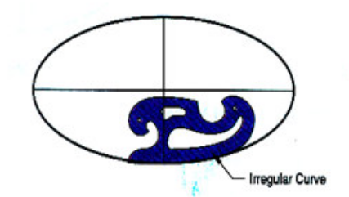
FRENCH CURVES

Slide 10
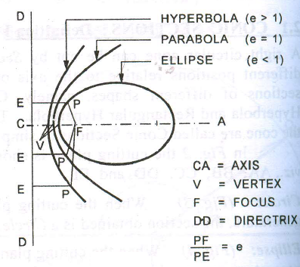
Conic is defined as the locus of a point moving in a plane such that the ratio of its distance from a fixed point (F) to the fixed straight line is always a constant.
The ratio is called eccentricity (e).
Moving point P
Fixed point is called the Focus (F)
Fixed line is called the Directrix (DD)
Axis (CA) is the line passing though F and perpendicular to DD
Vertex (V) is a point where the conic cuts the axis
Eccentricity (e) | Conic
<1 | Ellipse
1 | Parabola
>1 | Hyperbola

Slide 11
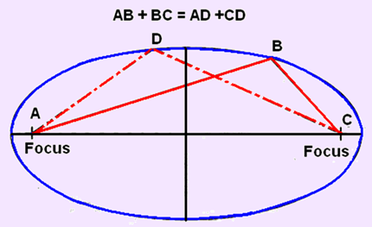
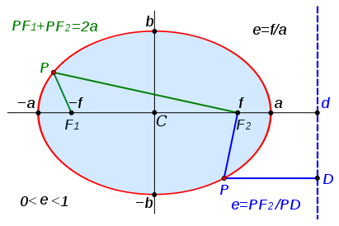
Ellipse
A curved line forming a closed loop, where the sum of the distances from two points (foci) to every point on the line is constant = Length of its major axis

Slide 12
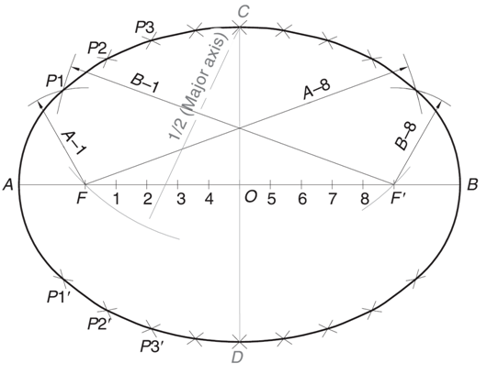
Relationship between Major axis, Minor axis and Foci
The sum of the distances of a point on the ellipse from the two foci is equal to the major axis
The distance of any end of the minor axis from any focus is equal to the half of the major axis
How to find Foci?
If minor axis (CD) is given instead of the distance between the foci, then the foci F and F’ can be located by cutting the arcs on major axis with C as a center and radius= ½ major axis= OA

Slide 13
Methods for Generating Ellipse
Focus-Directrix Or Eccentricity Method
General method of constructing any conic when the distance of the focus from the directrix and its eccentricity is given.
Concentric Method
This method is applicable when the major axis and minor axis of an ellipse are given
Oblong Method
This method is applicable when the major axis and minor axis or the conjugate axes with the angle between them is given.

Slide 14
Types of Problems
Focus-Directrix Or Eccentricity Method
Draw an ellipse if the distance of the focus from the directrix is 70 mm and the eccentricity is 3/4
Draw a parabola if the distance of the focus from the directrix is 55 mm
Draw a hyperbola of e = 4/3 and the distance of the focus from the directrix = 60 mm
Concentric Circle Method
Draw an ellipse having the major axis of 60 mm and the minor axis of 40 mm
Oblong Method
Draw an ellipse having conjugate axes of 60 mm and 40 mm long and inclined at 75⁰ to each other
Arc of Circle Method

Slide 15
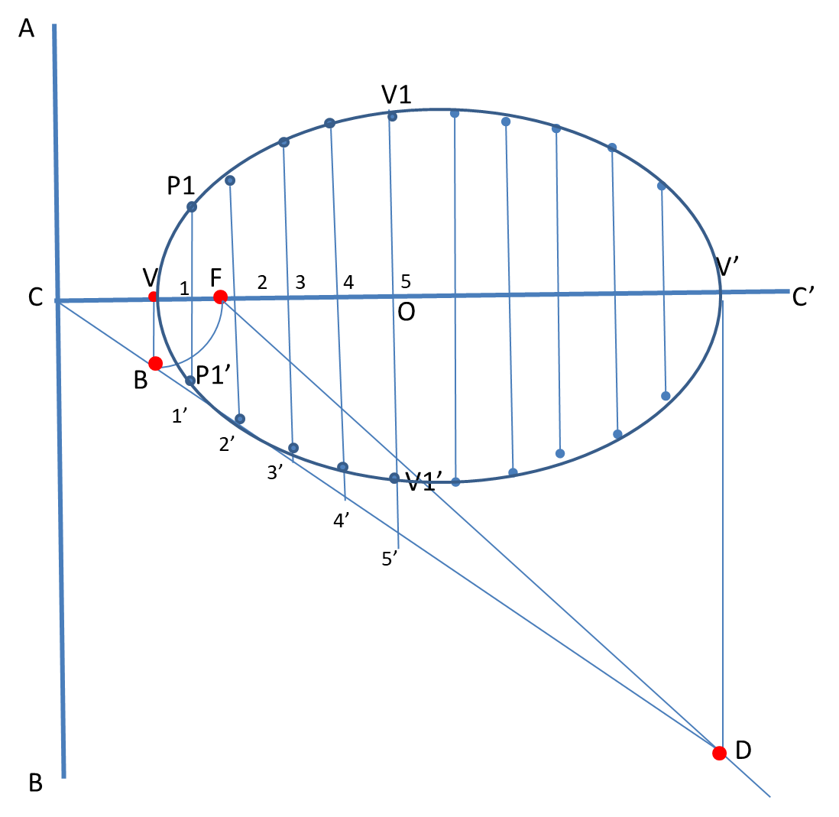
Steps for Focus-Directrix or Eccentricity Method
Q.1: Draw an ellipse if the distance of focus from the directrix is 70 mm and the eccentricity is 3/4.
Draw the directrix and axis.
Mark F on axis such that CF = 70 mm.
Divide CF into 3 + 4 = 7 equal parts and mark V at the fourth division from C. Now, e = FV/ CV = 3/4.
At V, erect a perpendicular VB = VF. Join CB.
Through F, draw a line at 45° to meet CB produced at D. Through D, drop a perpendicular DV’ on CC’. Mark O at the midpoint of V– V’.
Mark a few points, 1, 2, 3, … on V– V’ and erect perpendiculars through them meeting CD at 1’, 2’, 3’…. Also erect a perpendicular through O.
With F as a centre and radius = 1–1’, cut two arcs on the perpendicular through 1 to locate P1 and P1’. Similarly, with F as a centre and radii = 2–2’, 3–3’, etc., cut arcs on the corresponding perpendiculars to locate P2 and P2’, P3 and P3’, etc. Also, cut similar arcs on the perpendicular through O to locate V1 and V1’.

Slide 16
V₁
DIRECTRIX
v
F
3
4
5
V’
c
1
2
45◦
O
AXIS
B
1’
2’
3’
V₁’
4’
5’
D

Slide 17
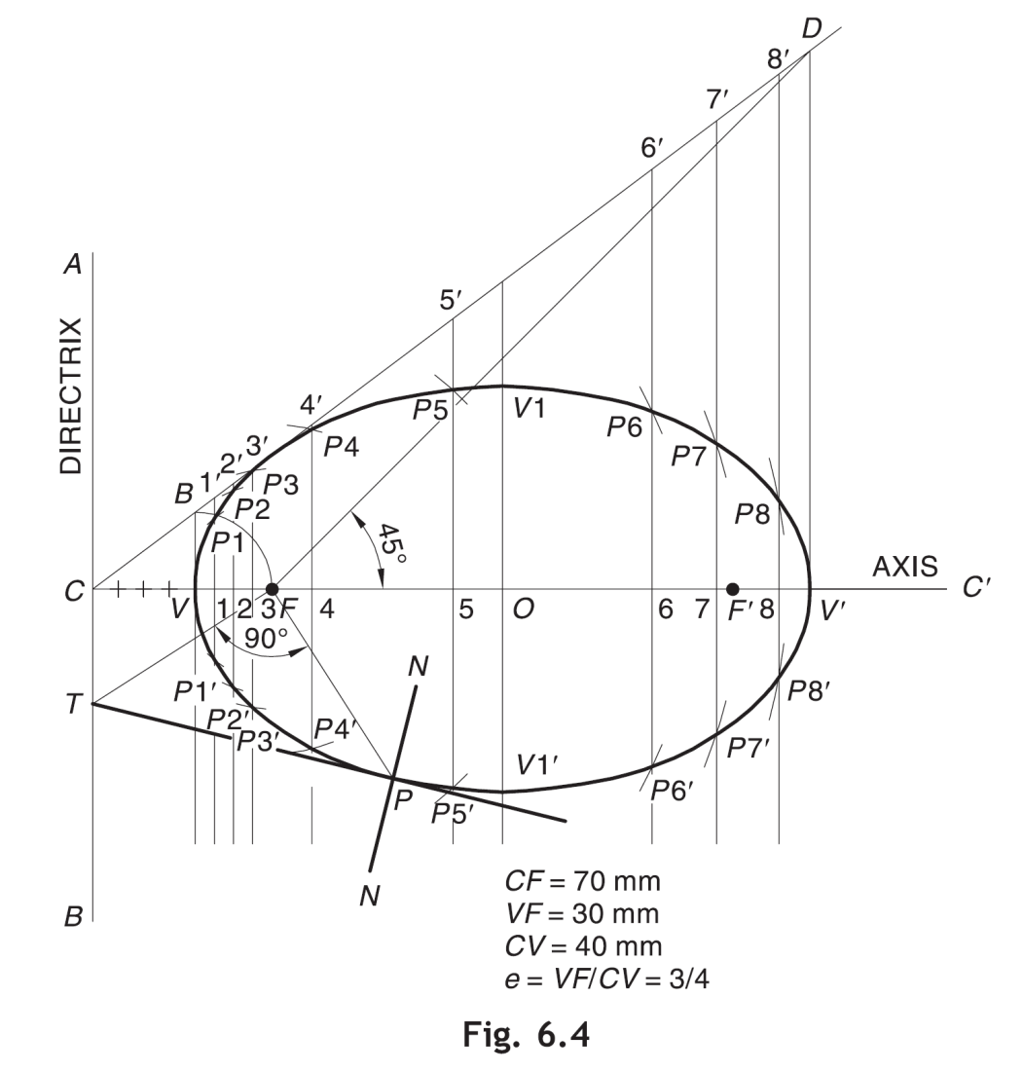
Focus-Directrix or Eccentricity Method

Slide 18
ELLIPSE
BY CONCENTRIC CIRCLE METHOD
Draw an ellipse having the major axis of 70 mm and the minor axis of 40 mm.
Steps:
1. Draw both axes as perpendicular bisectors of each other & name their ends as shown.
2. Taking their intersecting point as a center, draw two concentric circles considering both as respective diameters.
3. Divide both circles in 12 equal parts & name as shown.
4. From all points of outer circle draw vertical lines downwards and upwards respectively.
5.From all points of inner circle draw horizontal lines to intersect those vertical lines.
6. Mark all intersecting points properly as those are the points on ellipse.
7. Join all these points along with the ends of both axes in smooth possible curve. It is required ellipse.
3
2
4
C
1
3
5
2
4
1
5
A
B
10
6
10
9
8
7
6
D
9
7
8

Slide 19
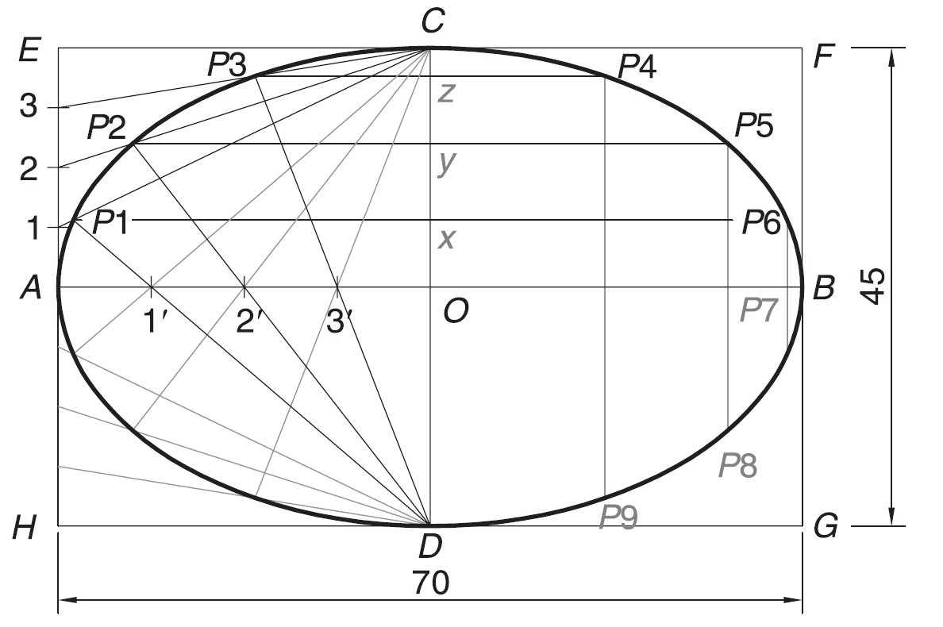
Steps for Oblong Method
Draw an ellipse with a 70 mm long major axis and a 45 mm long minor axis.
or
Draw an ellipse circumscribing a rectangle having sides 70 mm and 45 mm.
Draw the major axis AB = 70 mm and minor axis CD = 45 mm, bisecting each other at right angles at O.
Draw a rectangle EFGH such that EF = AB and FG = CD.
Divide AO and AE into same number of equal parts, say 4. Number the divisions as 1, 2, 3 and 1’, 2’, 3’, starting from A.
Join C with 1, 2 and 3.
Join D with 1’ and extend it to meet C–1 at P1. Similarly, join D with 2’ and 3’ and extend them to meet C–2 and C–3 respectively to locate P2 and P3.

Slide 20
C
P₃
3
P₂
2
P₁
1
A
1’
2’
3’
O
B
D
Oblong Method

Slide 21
Generating an ellipse (Oblong – parallelogram Method)
Draw ellipse by Oblong method.
Draw a parallelogram of 100 mm and 70 mm long sides with included angle of 75^{0.}Inscribe Ellipse in it.
STEPS ARE SIMILAR TO
THE PREVIOUS CASE
(RECTANGLE METHOD)
ONLY IN PLACE OF RECTANGLE,
HERE IS A PARALLELOGRAM.
Used when the conjugate axes with the angle
between them is given.
D
4
4
3
3
2
2
1
1
A
1
3
4
3
2
1
B
2
C

Slide 22
Generating an ellipse (Arc of circle method)
Major axis AB & minor axis CD are 100 & 70mm long respectively. Draw ellipse by arcs of circles method.
STEPS:
1.Draw both axes as usual.Name the
ends & intersecting point
2.Taking AO distance I.e.half major
axis, from C, mark F₁ & F₂ On AB .
( focus 1 and 2.)
3.On line F₁- O taking any distance,
mark points 1,2,3, & 4
4.Taking F₁ center, with distance A-1
draw an arc above AB and taking F₂
center, with B-1 distance cut this arc.
Name the point p₁
5. Intersection points of the two arcs are points on the ellipse.
6.Repeat this step with same centers but
taking now A-2 & B-2 distances for
drawing arcs. Name the point p₂
7.Similarly get all other P points.
With same steps positions of P can be
located below AB.
8.Join all points by smooth curve to get
an ellipse. (use a french curve).
p₄
C
p₃
p₂
p₁
A
B
F₁
1 2 3 4
O
F₂
D
As per the definition Ellipse is locus of point P moving in
a plane such that the SUM of it’s distances from two fixed
points (F₁ & F₂) remains constant and equals to the length
of major axis AB.(Note A .1+ B .1=A . 2 + B. 2 = AB)

Slide 23
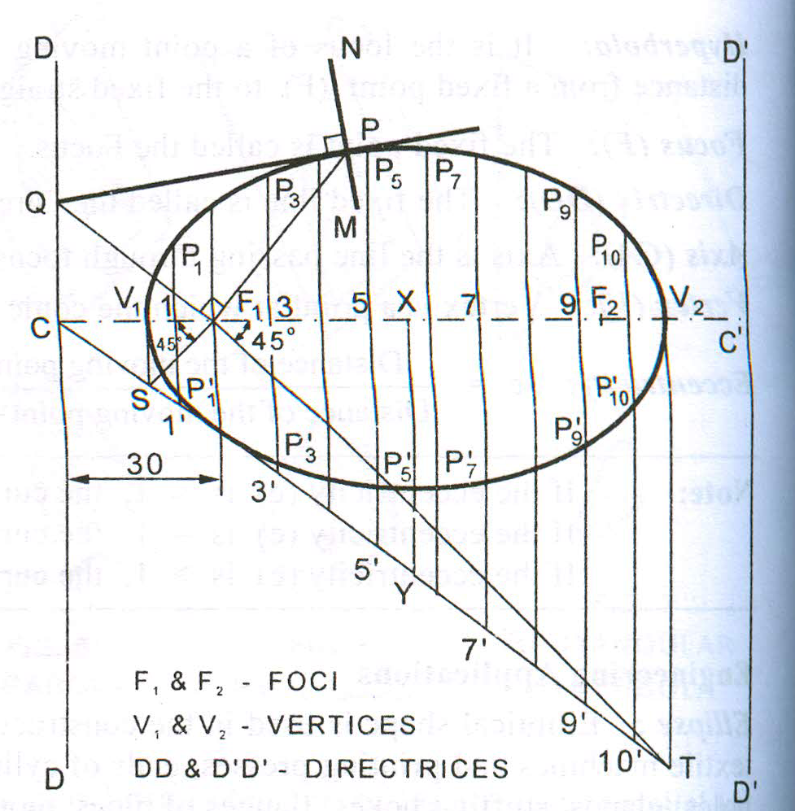
Tangent and Normal at any point P on the ellipse using Directrix
Mark the given point P and join PF₁ .
At F₁ draw a line perpendicular to PF₁ to cut DD at Q.
Join QP and extend it. QP is the tangent at P
Through P, draw a line NM perpendicular to QP. NM is the normal at P

Slide 24
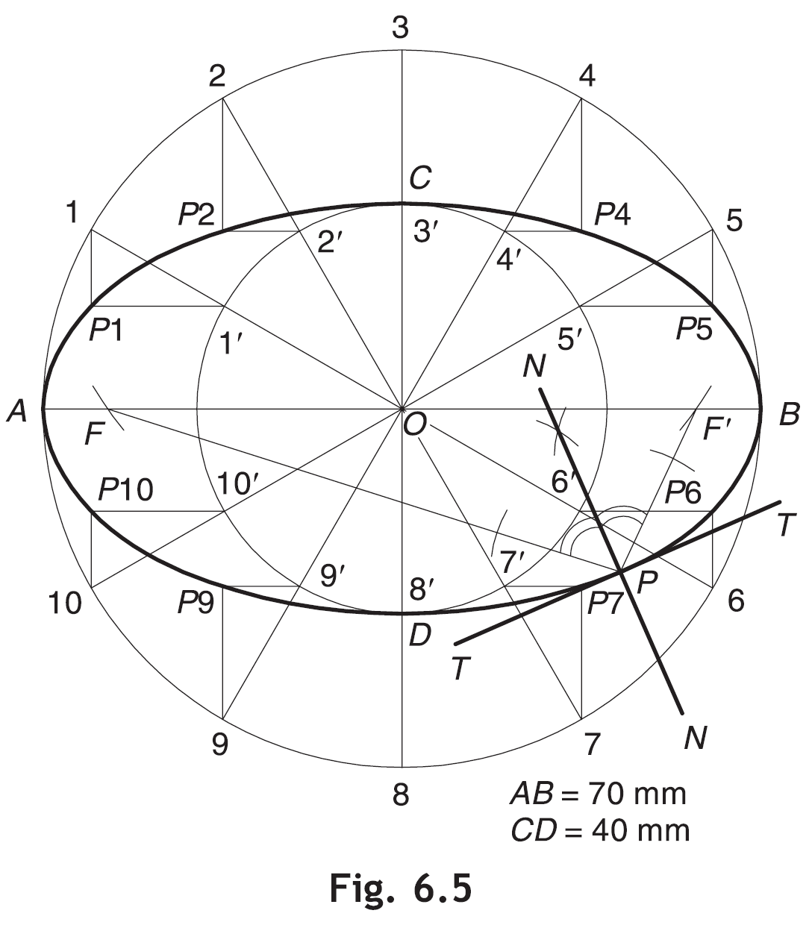
Tangent and Normal at any point P when Focus and Directrix are not known
First obtain the foci F and F′ by cutting the arcs on major axis with C as a centre and radius =OA
Obtain NN, the bisector of ∠FPF′. N-N is the required normal
Draw TT perpendicular to N-N at P. T-T is the required tangent

Slide 25
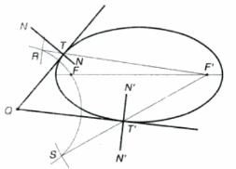
Tangent & Normal from a point outside ellipse
With Q as center and radius = QF, draw arc
With F’ as center and radius = major axis draw arc to cut previous at R & S
Join RF’ & SF’, cutting ellipse at T & T’ resp.
Join QT & QT’ to represent the required tangent. Draw N-N & N’-N’, perpendicular to QT & QT’ at T & T’ resp. for normals.

Slide 26
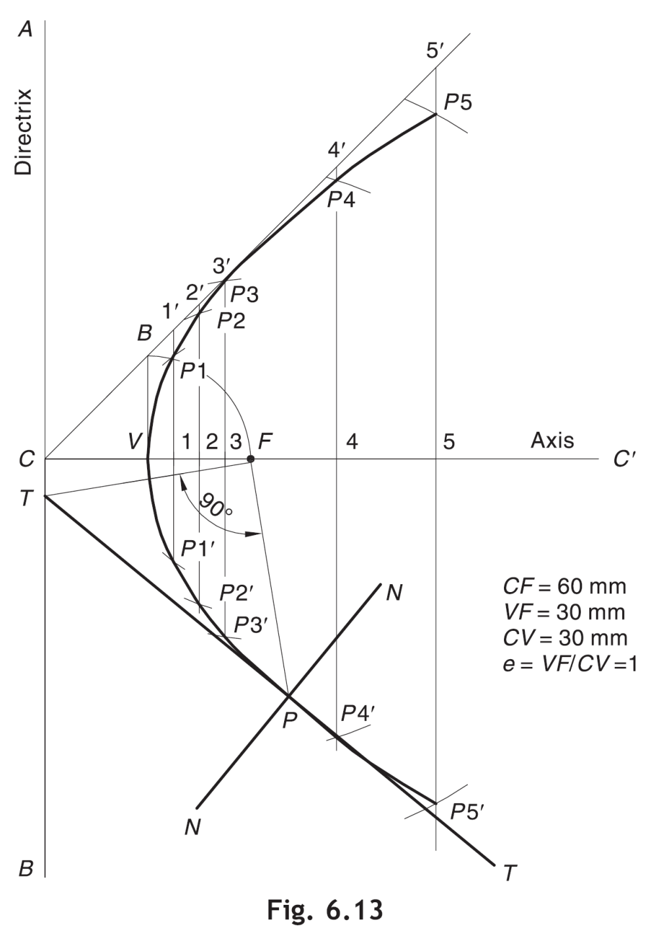
Parabola
A parabola is a conic whose eccentricity is equal to 1. It is an open-end curve with a focus, a directrix and an axis.
Any chord perpendicular to the axis is called a double ordinate.
The double ordinate passing through the focus represents the latus rectum
The double ordinate passing through the ends of the parabola, is called the base.
The shortest distance of the vertex from any ordinate, is known as the abscissa.

Slide 27
Methods for Generating Parabola
Focus-Directrix Or Eccentricity Method
General method of constructing any conics when the distance of the focus from the directrix is known and e=1.
For example, draw a parabola if the distance of the focus from the directrix is 55 mm.
Rectangle Method and Parallelogram Method
This method is applicable when the axis (or abscissa) and the base ( or double ordinate) of a parabola are given or the conjugte axes with the angle between them is given
For example, draw a parabola having an abscissa of 30 mm and the double ordinate are 70 mm, or
Draw an parabola having conjugate axes of 60 mm and 40 mm long and inclined at 75⁰ to each other.
Tangent Method
This method is applicable when the base and the inclination of tangents at open ends of the parabola with the base are given
For example, draw a parabola if the base is 70 mm and the tangents at the base ends make 60° to the base.

Slide 28
Steps for Focus-Directrix or Eccentricity Method
Draw a parabola if the distance of the focus from the directrix is 60 mm.
Draw directrix AB and axis CC’ as shown.
Mark F on CC’ such that CF = 60 mm.
Mark V at the midpoint of CF. Therefore, e = VF/ VC = 1.
At V, erect a perpendicular VB = VF. Join CB.
Mark a few points, say, 1, 2, 3, … on VC’ and erect perpendiculars through them meeting CB produced at 1’, 2’, 3’, …
With F as a centre and radius = 1–1’, cut two arcs on the perpendicular through 1 to locate P1 and P1’. Similarly, with F as a centre and radii = 2–2’, 3–3’, etc., cut arcs on the corresponding perpendiculars to locate P2 and P2’, P3 and P3’, etc.
Draw a smooth curve passing through V, P1, P2, P3 … P3

Slide 29
5’
4’
3’
2’
1’
B
DIRECTRIX
v
F
3
4
5
c
1
2
AXIS

Slide 30
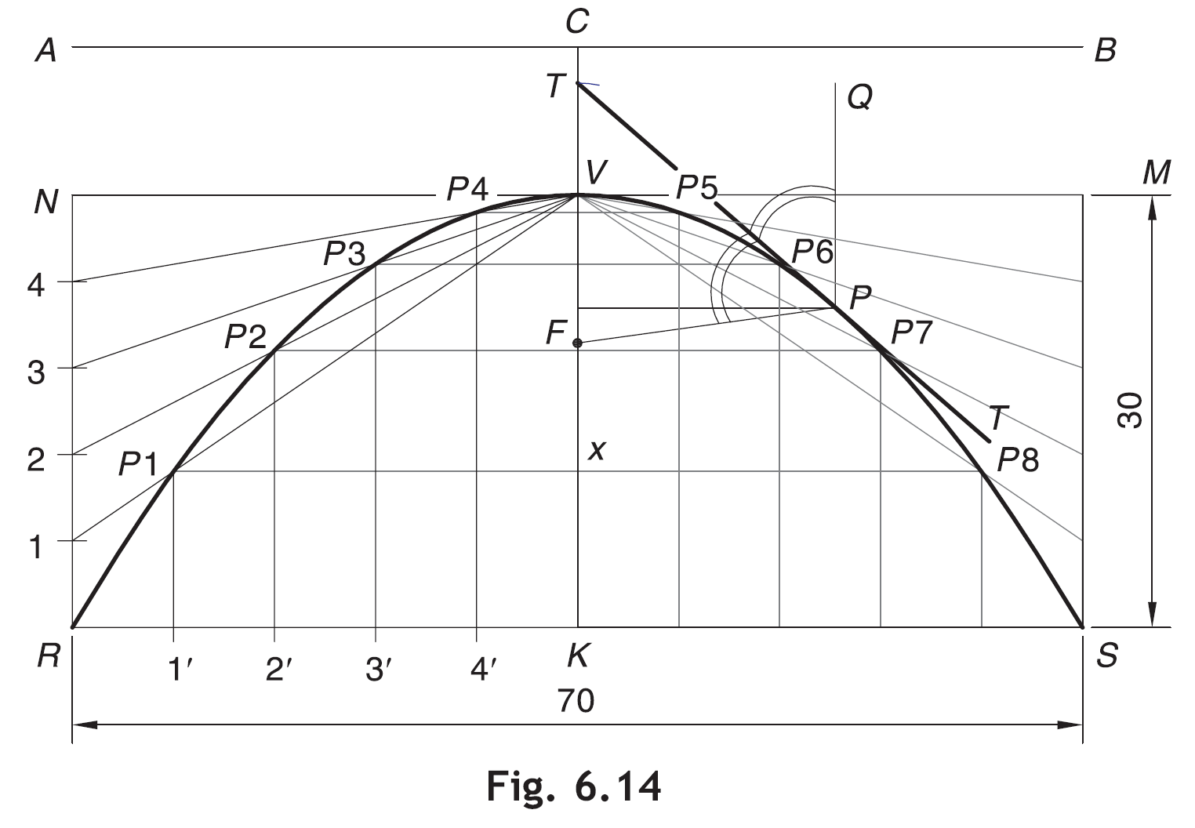
Steps for Rectangle Method
Q.1: Draw a parabola having an abscissa of 30 mm and the double ordinate of 70 mm.
Draw the double ordinate RS = 70 mm. At midpoint K erect a perpendicular KV = 30 mm to represent the abscissa.
Construct a rectangle RSMN such that SM = KV.
Divide RN and RK into the same number of equal parts, say 5. Number the divisions as 1, 2, 3, 4 and 1’, 2’, 3’, 4’, starting from R.
Join V–1, V–2, V–3 and V–4.
Through 1’, 2’, 3’ and 4’, draw lines parallel to KV to meet V–1 at P1, V–2 at P2, V–3 at P3 and V–4 at P4, respectively.
Obtain P5, P6, P7 and P8 in the other half of the rectangle in a similar way. Alternatively, these points can be obtained by drawing lines parallel to RS through P1, P2, P3 and P4. For example, draw P1– P8 such that P1– x = x– P8.
Join P1, P2, P3 … P8 to obtain the parabola.

Slide 31
Steps for Tangent and Normal at a point P on parabola
Join PF. Draw PQ parallel to the axis.
Draw the bisector T– T of – FPQ to represent the required tangent.
Draw normal N– N perpendicular T– T at P.

Slide 32
Generating parabola (Rectangle method)
6
6
5
5
4
4
3
3
2
2
1
1
1
2
3
4
5
6
5
4
3
2
1

Slide 33
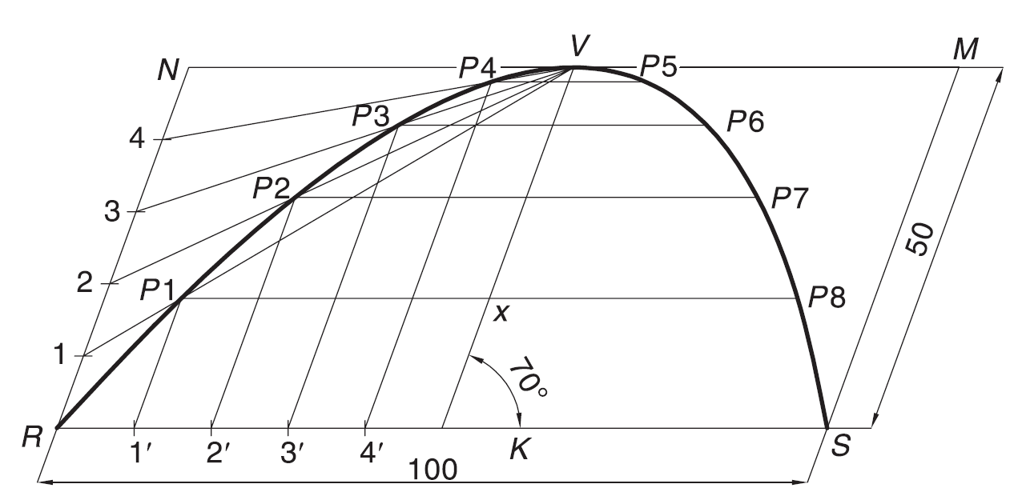
Steps for Parallelogram Method
Q.1: Draw a parabola of base 100 mm and axis 50 mm if the axis makes 70° to the base.
Draw the base RS = 100 mm and through its midpoint K, draw the axis KV = 50 mm, inclined at 70° to RS.
Draw a parallelogram RSMN such that SM is parallel and equal to KV.
Follow steps as in rectangle method

Slide 34
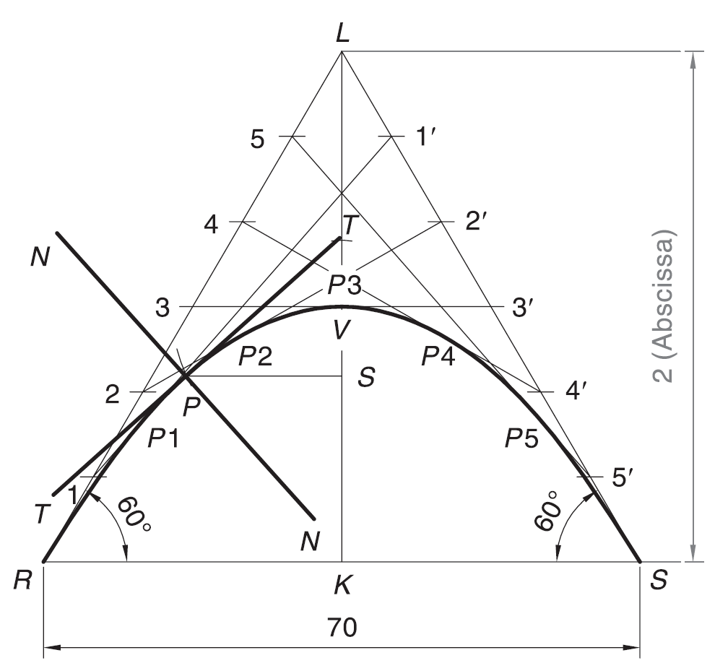
Steps for Tangent Method
Q. Draw a parabola if the base is 70 mm and the tangents at the base ends make 60° to the base.
Draw the base RS = 70 mm. Through R and S, draw the lines at 60° to the base, meeting at L.
Divide RL and SL into the same number of equal parts, say 6. Number the divisions as 1, 2, 3 … and 1’, 2’, 3’, … as shown.
Join 1–1’, 2–2’, 3–3’, ….
Draw a smooth curve, starting from R and ending at S and tangent to 1–1’, 2–2’, 3–3’, etc., at P1, P2, P3, etc., respectively
Method to draw tangent at a point on parabola 1. Locate the point P on the curve
2. Draw the ordinate PS 3. On LK, mark T such that TV =VS
4. Join TP and extend to obtain tangent TT 5.Draw normal N-N perpendicular to T-T at P

Slide 35
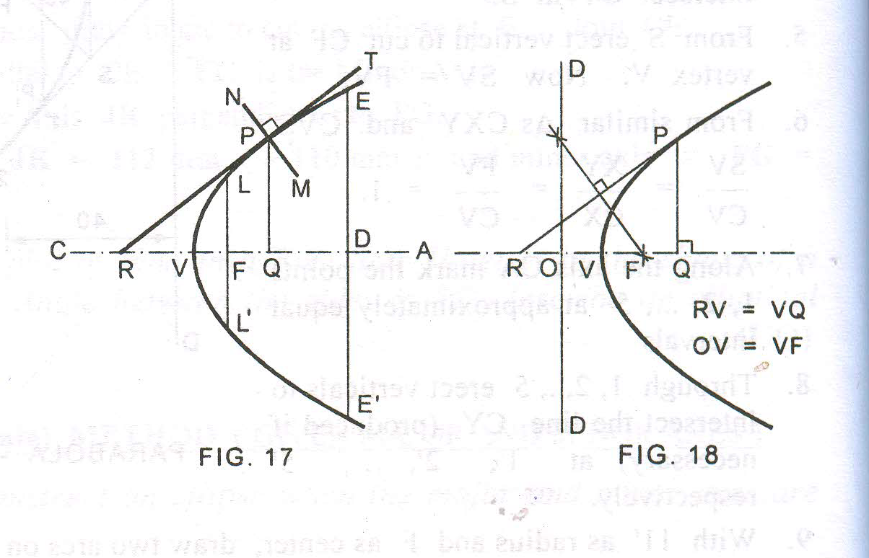
Tangent and Normal at any point P when Focus and Directrix are not known
Draw the ordinate PQ
Find the abscissa VQ
Mark R on CA such that RV=VQ
Draw the normal NM perpendicular to RP at P
To find the focus and the directrix of a parabola given its axis
Mark any point P on the parabola
Draw a perpendicular PQ to the given axis
Mark a point R on the axis such that RV=VQ
Focus: Join RP. Draw a perpendicular bisector of RP cutting the axis at F, F is the focus
Directrix: Mark O on the axis such that OV= VF. Through O draw the directrix DD perpendicular to the axis

Slide 36
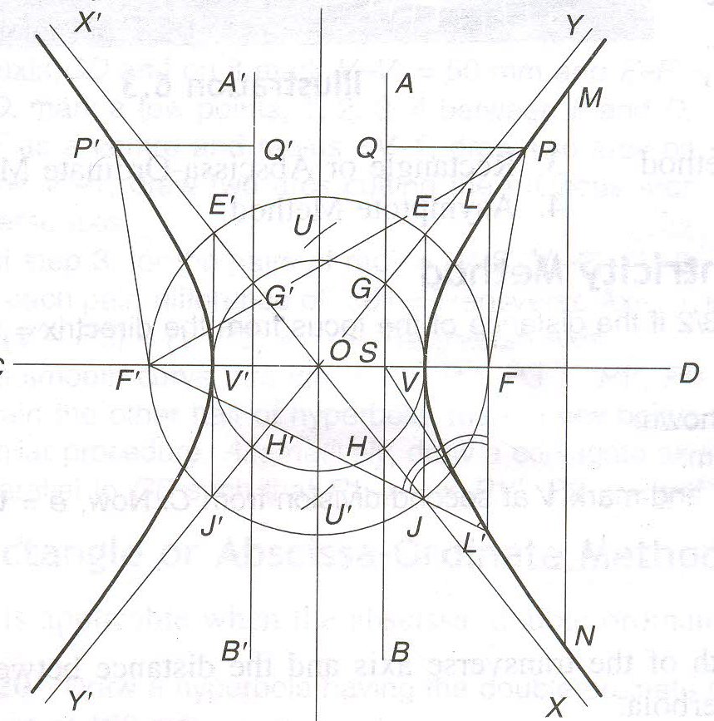
Hyperbola e>1
The hyperbolas is an open-end curve and exist in a pair. It has two foci ( F and F′), two directrices (AB and A′B′), an axis and two vertices (V and V′)
Transverse axis or Major axis : Line joining two vertices.
Conjugate axis: Line perpendicular to transverse axis at centre of hyperbola (O)
Double ordinate(MN): Any chord, Say MN , perpendicular to the axis
Abscissa: Distance of the nearest vertex from the given ordinate.
Asymptotes: The two lines X-X′ and Y-Y′ intersecting at O
Directrix (GH and G′H′): O as centre and OV and OV′ as radius, draw arcs to cut the asymptotes.
Draw a circle with O as centre and radius OF. Draw perpendicular to (V V′) at V and V′ cutting the circle at E′, J. The diagonals E, J′ are the asymptotes

Slide 37
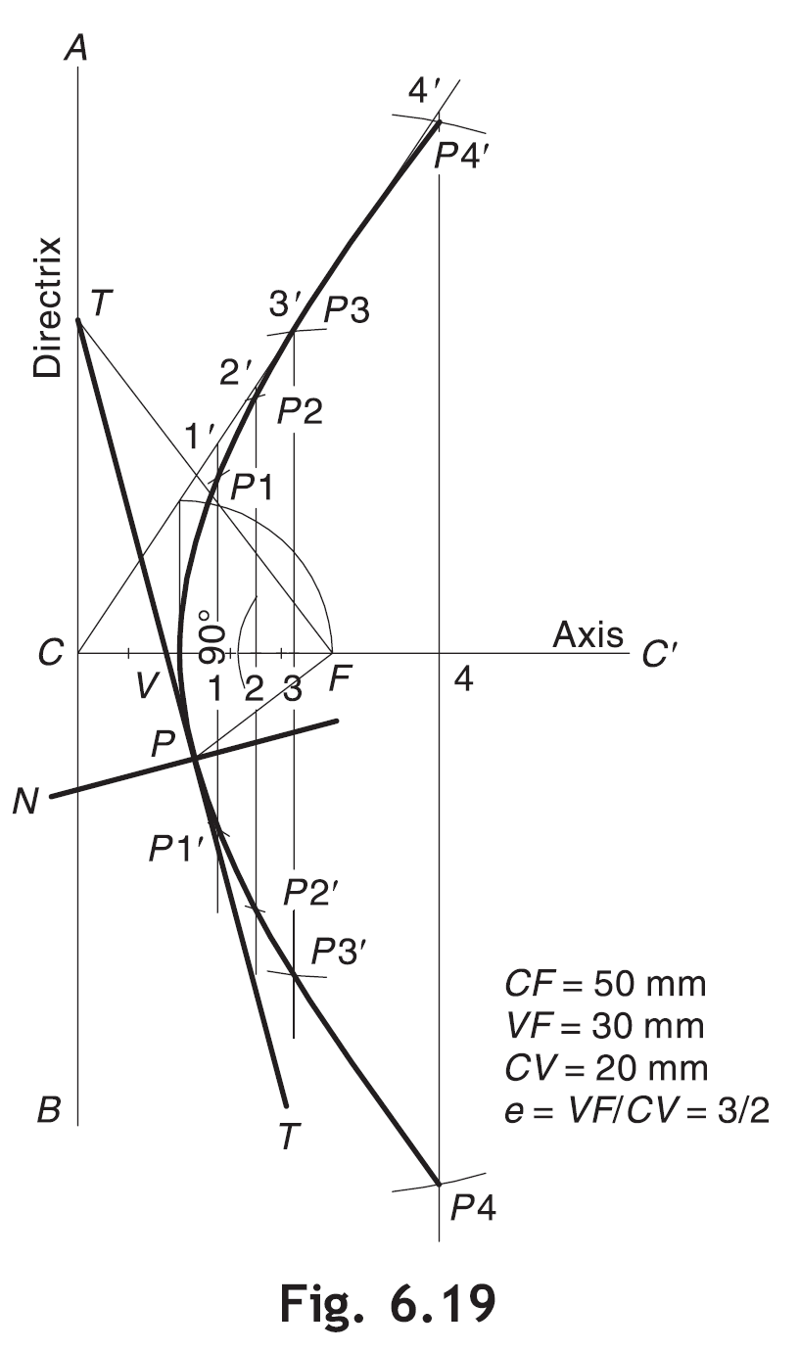
Steps for Focus-Directrix or Eccentricity Method
Draw a hyperbola of e = 3/2 if the distance of the focus from the directrix = 50 mm.
Draw directrix AB and axis CC’ as shown.
Mark F on CC’ such that CF = 50 mm.
Divide CF in to 3 + 2 = 5 equal parts and mark V at second division from C. Now, e = VF/ VC = 3/2.
Follow steps as in ellipse and parabola

Slide 38
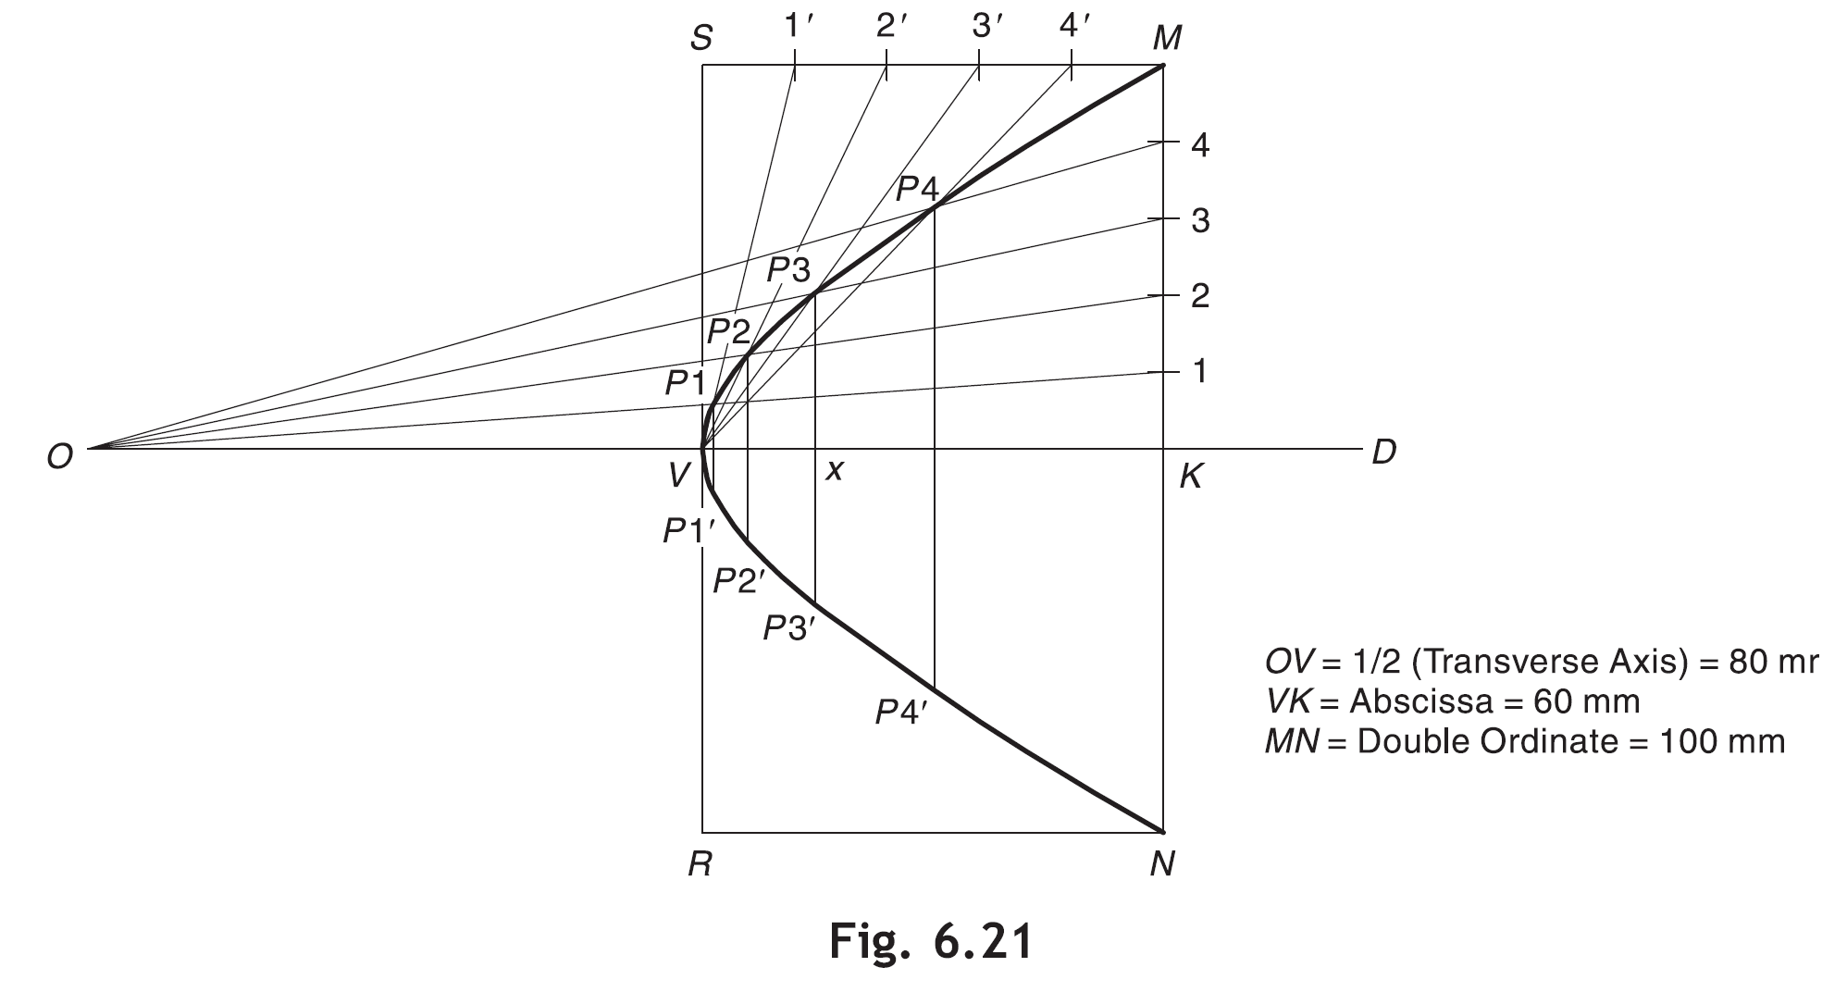
Steps for Rectangle or Abscissa-Ordinate Method
Draw a hyperbola having the double ordinate of 100 mm, the abscissa of 60 mm and the transverse axis of 160 mm
Draw axis OD and mark V and K on it such that OV = 1/2(Transverse Axis) = 80 mm and VK =Abscissa = 60 mm.
Through K, draw double ordinate MN = 100 mm.
Construct rectangle MNRS such that NR = VK.
Divide MK and MS into the same number of equal parts, say 5. Number the divisions as shown.
Join O–1, O–2, O–3, etc. Also join V–1’, V–2’, V–3’, etc. Mark P1, P2, P3, etc., at the intersections of O–1 and V–1’, O–2 and V–2’, O–3 and V–3’, etc., respectively.
6. Similarly obtain P1’, P2’, P3’, etc., for other half. Alternatively, draw P1/ P1’, P2/P2’, P3/P3’, etc., such that P3 –x = x–P3’ and likewise.

Slide 39
ENGINEERING CURVES
Part-II
(Point undergoing two types of displacements)
Roulettes
• Roulettes are curves generated by the rolling contact of one curve
or line on another curve or line
• There are various types of roulettes
• The most common types of roulettes used in engineering practice
are:
Involutes and Cycloids

Slide 40
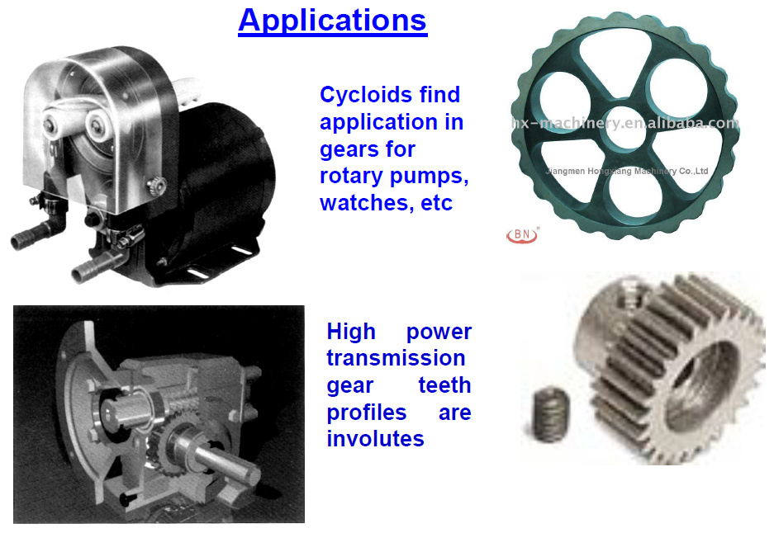

Slide 41
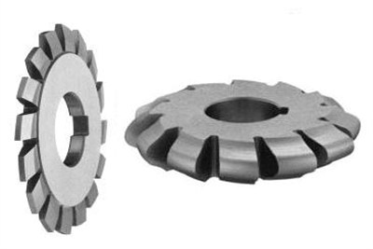
Involutes
An involute is a curve traced by the free end of a thread unwound from a circle or a polygon, in such a way that the thread is always tight and tangential to the circle or the sides of the polygon.
Depending on whether the involute is traced over a circle or a polygon, the involute is called an involute of circle or involute of polygon
Application…..
Involute gear

Slide 42
Two involute gears, Left driving the Right
Blue arrows show the contact forces between them.
Application…..
Points of contact move:
As if a string is being unwound from the left rotating base circle,
and wound onto the right rotating base circle.

Slide 43
INVOLUTE OF A CIRCLE
Draw the involute of a circle, 40 mm in diameter. Also draw the tangent and normal at a point on the curve at a distance of 100 mm from the centre of the circle.
Solution Steps:
1) Point or end P of string AP is exactly πD distance away from A. Means if this string is wound round the circle, it will completely cover given circle. P will meet A after winding.
2) Divide πD (AP) distance into 8 number of equal parts.
3) Divide circle also into 8 number of equal parts.
4) Name after A, 1, 2, 3, 4, etc. up to 8 on πD line AP as well as on circle (in anticlockwise direction).
5) To radius C-1, C-2, C-3 up to C-8 draw tangents (from 1,2,3,4,etc to circle).
6) Take distance 1 to P in compass and mark it on tangent from point 1 on circle (means one division less than distance AP).
7) Name this point P1
8) Take 2-B distance in compass and mark it on the tangent from point 2. Name it point P2.
9) Similarly take 3 to P, 4 to P, 5 to P up to 7 to P distance in compass and mark on respective tangents and locate P3, P4, P5 up to P8 (i.e. A) points and join them in smooth curve it is an INVOLUTE of a given circle.
P₂
P₃
P₁
2 to p
3 to p
1 to p
P₄
4 to p
4
3
5
2
5 to p
6
7
1
A
8
P
P₅
6 to p
7 to p
P₈
1 2
3 4
7 8
5 6
P₇
P₆
πD
String length is equal to the circumference of circle.

Slide 44
Draw the involute of a circle, 40 mm in diameter. Also draw the tangent and normal at a point on the curve at a distance of 100 mm from the centre of the circle.
5
6
7
4
8
3
9
2
10
PQ=perimeter of circle
1
11
P
1′
2′
3′
4′
5′
6′
7′
8′
9′
10′
11′
Q

Slide 45
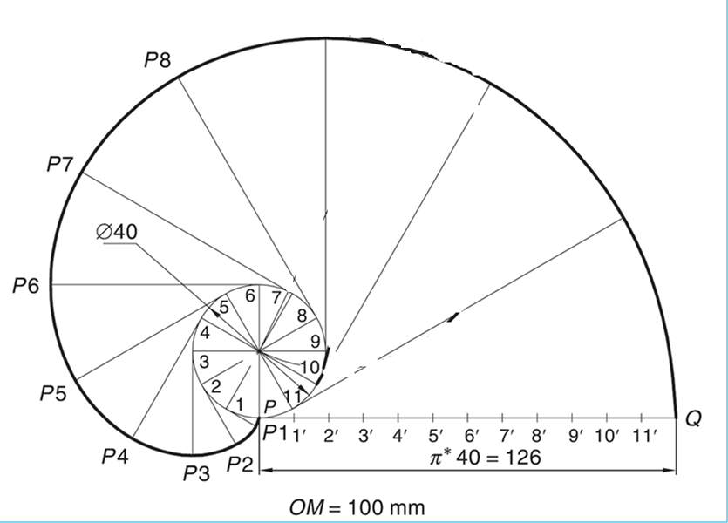
Involute

Slide 46
Steps:
Draw involute as usual.
Mark point Q on involute as given.
Join Q to the center of circle C.
Considering CQ as diameter, draw a semicircle as shown.
Mark the point of intersection of this semicircle and pole circle and join it to Q.
This will be normal to involute.
Draw a line at right angle to this line from Q to get tangent to the involute.
Method for Drawing
Tangent & Normal
INVOLUTE OF A CIRCLE
Normal
Q
Tangent
4
3
5
C
2
6
7
1
8
P
P₈
1 2
3 4
5 6
7 8
πD

Slide 47
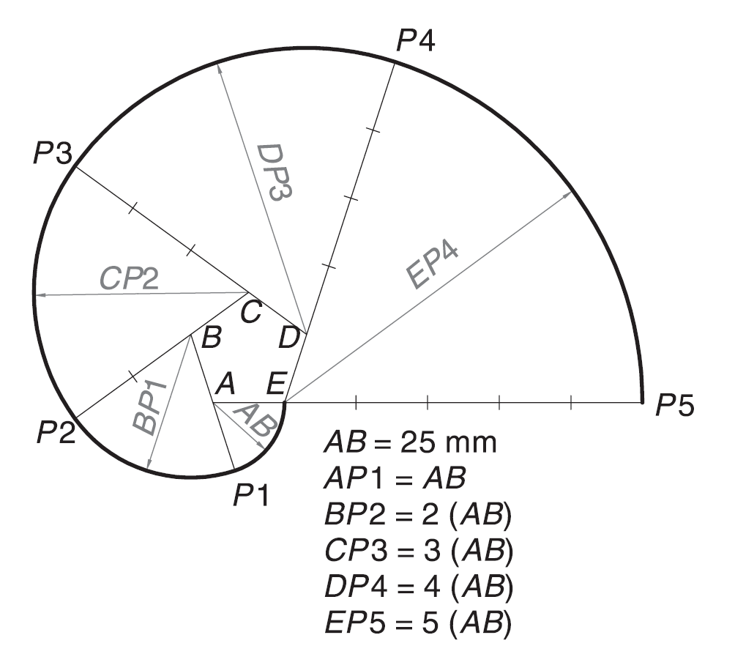
Involute of Polygon: Draw the involute of a pentagon of 25 mm side.

Slide 48
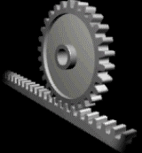
CYCLOID
A Cycloid is generated by a point on the circumference of a circle rolling along a straight line, without being slipped
The rolling circle is called a generating circle and the straight line is called a directing line or base line.
The point on the generating circle which traces the curve is called the generating point.

Slide 49
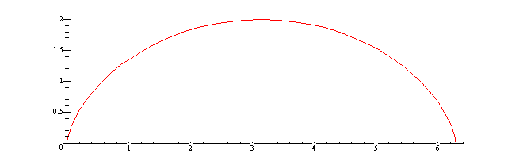
CYCLOID
The cycloid is called an epicycloid when the generating circle rolls along another circle outside it.
Hypocycloid, opposite to the epicycloid, is obtained when the generating circle rolls along another circle inside it.
The other circle along which the generating circle rolls is called the directing circle or the base circle.

Slide 50
Cycloid
A wheel of diameter 60 cm rolls on a straight horizontal road. Draw the locus of a point P on the periphery of the wheel, for one revolution of the wheel, if P is initially on the road.
Steps:
Draw the base line P’–P” equal to the circumference of generating circle, i.e., πx 60 cm = 188 cm.
Draw the generating circle with C as centre and radius = 30 cm, tangent to P’ –P” at P’. Point P is initially at P’.
Draw C–C” parallel and equal to P’ –P” to represent the locus of the centre of the generating circle.
Obtain 12 equal divisions on the circle. Number the divisions as 1, 2, 3, etc., starting from P’ as shown. Through 1, 2, 3, etc., draw lines parallel to P’ –P”.
Obtain 12 equal divisions on C–C” and name them as C1, C2, C3, etc.
With C1, C2, C3, etc. as the centres and radius = CP’ = 30 mm, cut the arcs on the lines through 1, 2, 3, etc., to locate respectively P1, P2, P3, etc.
Join P’, P1, P2, P3, etc. by a smooth curve.

Slide 51
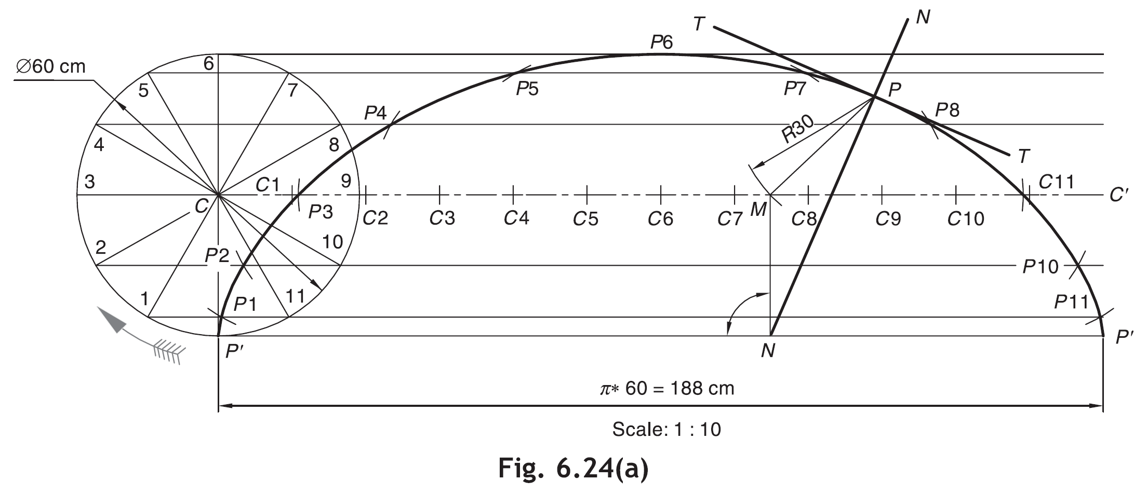
Cycloid
6
5
7
4
8
9
3
C1
C2
C3
C4
C5
C6
C7
C8
C9
C10
C11
C12
2
10
1
11
P′
P′’

Slide 52
STEPS:
DRAW THE CYCLOID.
MARK POINT Q AS GIVEN.
FROM Q, CUT THE POINT ON LOCUS OF C (C-C₈) AS R AND JOIN IT TO Q. RQ=CP.
FROM THIS POINT R DROP A PERPENDICULAR ON GROUND LINE AND NAME IT AS N
JOIN N WITH Q.THIS WILL BE NORMAL TO CYCLOID.
DRAW A LINE AT RIGHT ANGLE TO NORMAL TO GET TANGENT TO CYCLOID.
CYCLOID
Method of Drawing
Tangent & Normal
Normal
CYCLOID
Q
Tangent
CP
C₁ C₂ C₃ C₄ C₅ C₆ C₇ C₈
C
R
P
N
πD

Slide 53
Tangent and Normal to Cycloid
With P as a centre and radius = CP’ (i.e., radius of generating circle), cut an arc on the line C–C” at M.
From M, draw a normal MN to P’ –P”. In case of epicycloid and hypocycloid, this can be done by joining MO and then locating N at the intersection of P’ –P” and MO (produced if necessary).
Join NP for the required normal. Draw tangent T–T perpendicular to NP at P.

Slide 54
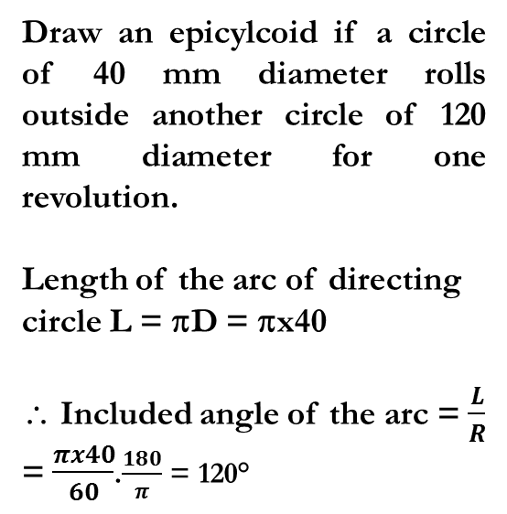
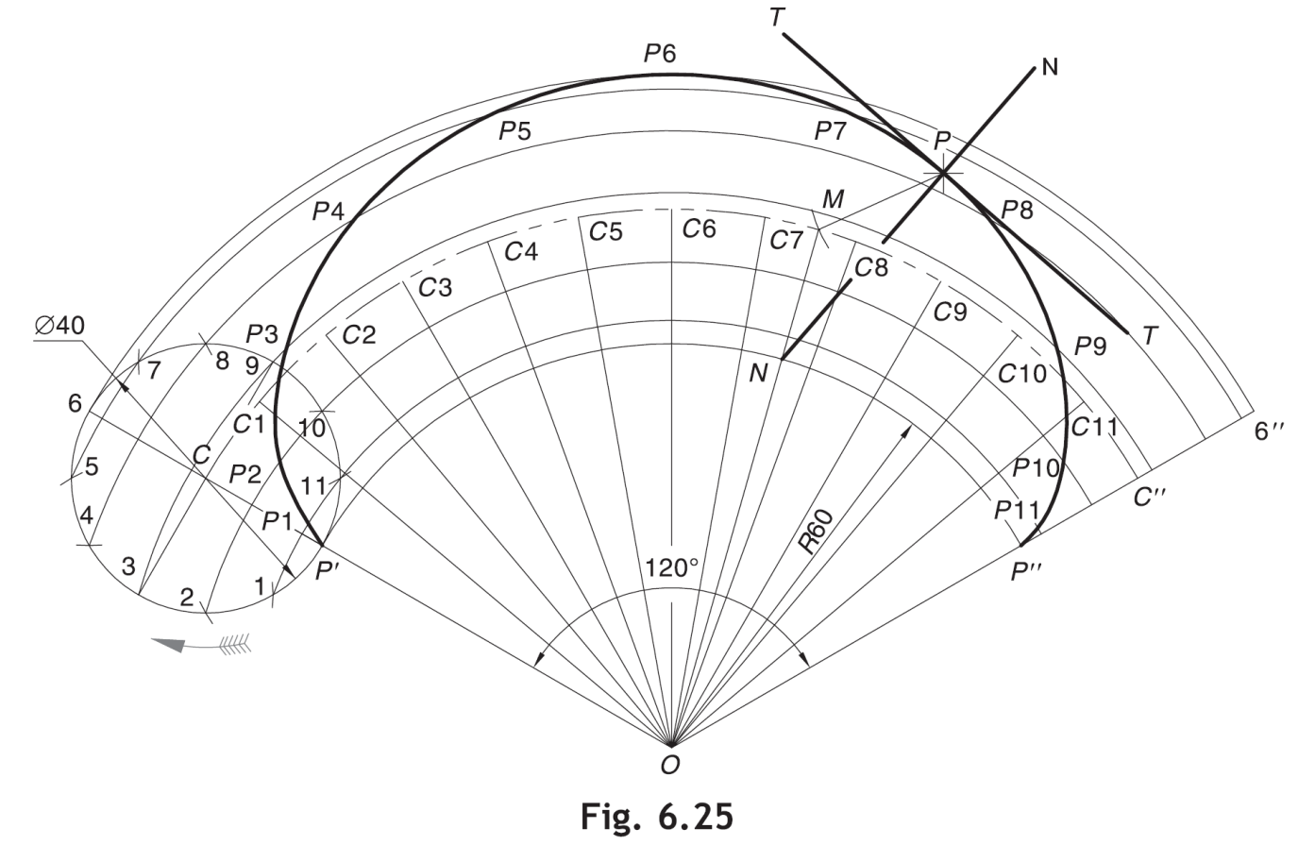
With O as a centre and radius = 60 mm, draw the directing arc P’ –P” which gives included angle 120°.
Produce OP’ and locate C on it such that CP’ = radius of generating circle = 20 mm. With C as centre and radius = CP’, draw a circle.
With O as a centre and radius = OC, draw an arc C–C” such that ∠COC” = 120°. Arc C–C” represents the locus of centre of generating circle.
Divide the circle into 12 equal parts. With O as a centre and radii = O–1, O–2, O–3, etc., draw the arcs through 1, 2, 3, etc., parallel to arc P’ –P”.
Remaining steps are same as that for cycloid discussed before.

Slide 55
DRAW LOCUS OF A POINT ON THE PERIPHERY OF A CIRCLE
WHICH ROLLS ON A CURVED PATH. Take diameter of rolling Circle 50 mm
And radius of directing circle i.e. curved path, 75 mm.
EPICYCLOID
Length of the arc of directing circle = πD = Rθ
Generating/
Rolling Circle
4
5
C₁
C₂
C₃
C₄
3
6
C
C₅
7
C₆
2
r = CP
1
P
C₇
Directing Circle
R
C₈
r
+
=
360⁰
R
O

Slide 56
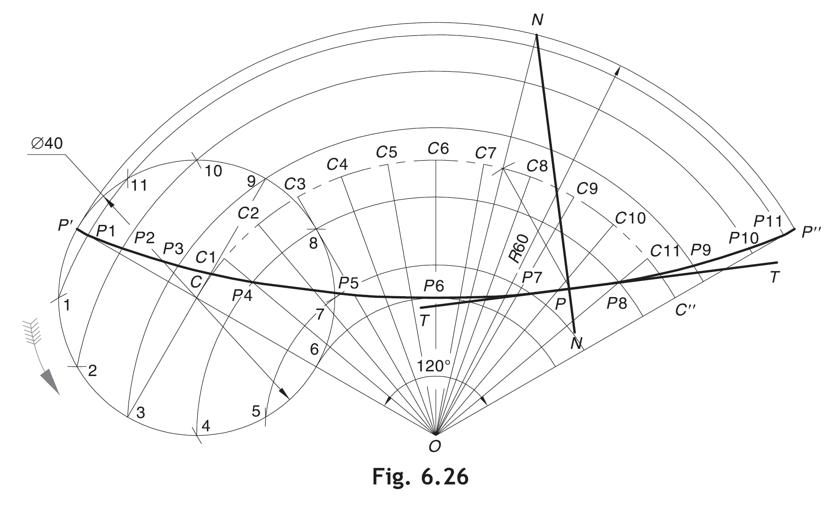
Hypocycloid
A circle of diameter 40 mm rolls inside another circle of radius 60 mm. Draw the hypocycloid traced by a point on the rolling circle initially in contact with the directing circle for one revolution.
Included angle of the arc, θ = ( D/ R × 180) = 40/60 × 180 = 120°.
With O as a centre and radius = 60 mm, draw the directing arc P’ –P” of included angle 120°.
On OP’, locate C such that CP’ = 20 mm. With C as a centre and radius = CP’, draw a circle.
Further follow the same steps as stated for cycloid and epicycloid.

Slide 57
HYPOCYCLOID
8
9
10
7
11
6
12
5
4
c₈
c₉
c₁₀
c₇
c₁₁
c₁₂
3
c₆
c₅
c₄
2
2’
3’
c₃
4’
c₂
1
1’
c₁
5’
θ
12’
P
C
6’
O
11’
7’
10’
9’
8’
OP=Radius of directing circle=75mm
PC=Radius of generating circle=25mm
θ=r/R X360º= 25/75 X360º=120º

Slide 58

Thank You for Patient Hearing

